Slide 1
Literature search
Materi Kuliah Metodologi Penelitian dan Rancangan Percobaan
TPHP-FTP UGM

Slide 2
OVERVIEW
Phenomena (part 1)
A literature search?
Step by step for literature search
Web based method
Web of Science
Scopus
Google Scholar
Citation? (part 2)
The quick guide to referencing
Systems for referencing
Citation Style
APA (American Psycological Association)
Harvard
Reference management software
Mendeley
How to check plagiarism

Slide 3
Phenomena
A phenomenon (plural, phenomena) is a general result that has been observed reliably in systematic empirical research. It is an established answer to a research question
Empirical research is based on observed and measured phenomena and derives knowledge from actual experience rather than from theory or belief.
Phenomena are often given names by their discoverers or other researchers, and these names can catch on and become widely known.
Nutraceuticals
Nutraceuticals have been used in prevention and treatment of diseases, like coronary heart disease, diabetes, cancer, and other chronic diseases, because they exerted antitumor, antioxidant, and antiinflammatory properties.
Example : Pomegranate health effects against cardiovascular disease, diabetes, and prostate cancer have been reported from human clinical trials.
GM food technology
GM plants and animals are used to enhance taste, shell life, nutrition and quality of food.
Example : the GM soy beans by Monsanto to resist the herbicide.

Slide 4
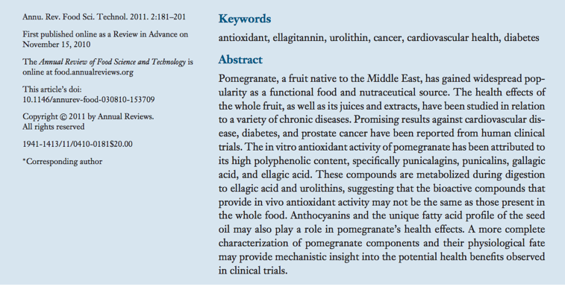
https://www.annualreviews.org/doi/pdf/10.1146/annurev-food-030810-153709

Slide 5
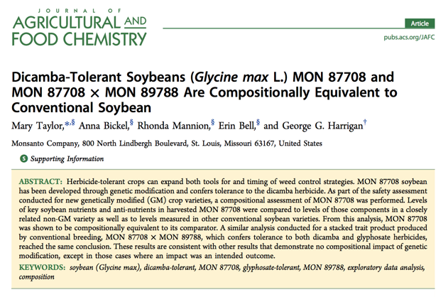
https://www.ncbi.nlm.nih.gov/pmc/articles/PMC3791249/
https://pubs.acs.org/doi/pdf/10.1021/acs.jafc.7b03844

Slide 6
A literature search?
Literature search is a systematic and well-organised search from the already published data to identify a breadth of good quality references on a specific topic.
The main purpose :
to formulate a research question by evaluating the available literature with an eye on gaps still amenable to further research.
Literature search is done to identify :
appropriate methodology
design of the study
population sampled and sampling methods
methods of measuring concepts
techniques of analysis
(Grewal et al., 2016)

Slide 7
Step by step for literature search
Identify keywords and use them to search articles from library and internet resources
Search several databases to search articles related to your topic
Use thesaurus to identify terms to locate your articles
Find an article that is similar to your topic; then look at the terms used to describe it, and use them for your search
Use databases that provide full-text articles (free through academic libraries, Internet or for a fee) as much as possible so that you can save time searching for your articles
If you are examining a topic for the first time and unaware of the research on it, start with broad syntheses of the literature, such as overviews, summaries of the literature on your topic or review articles

Slide 8
Continued..
Start with the most recent issues of the journals, and look for studies about your topic and then work backward in time. Follow-up on references at the end of the articles for more sources to examine
Refer books on a single topic by a single author or group of authors or books that contain chapters written by different authors
Next look for recent conference papers. Often, conference papers report the latest research developments. Contact authors of pertinent studies. Write or phone them, asking if they know of studies related to your area of interest
The easy access and ability to capture entire articles from the web make it attractive. However, check these articles carefully for authenticity and quality and be cautious about whether they represent systematic research.
(Creswell, 2014)

Slide 9
http://lib.ugm.ac.id/

Slide 10
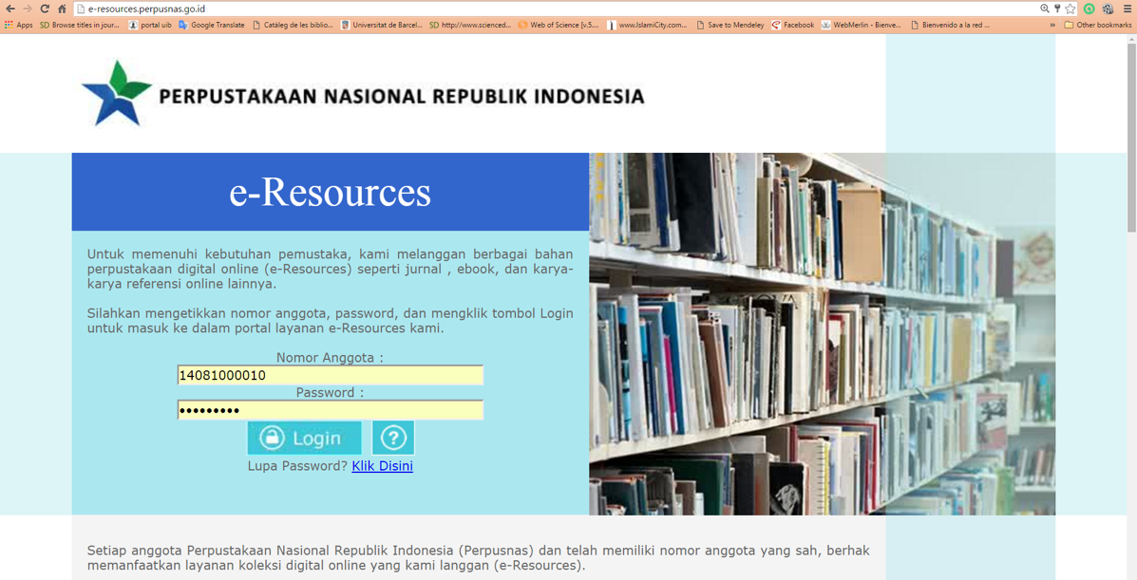
Widiastuti Setyaningsih widisety.com
Widiastuti Setyaningsih widisety.com

Slide 11
Web based methods
Search for a key article, title or the author in the collection :
Web of Science
Scopus
Google Scholar
ScienceDirect
Specific fields :
PubMed Central (PMC)
Medline
SciFinder Scholar's Chemical Abstracts
JSTOR

Slide 12
Access Web of Science (www.webofknowledge.com/).
Selected ‘basic Search’.
Enter the name of your topic (example : pomegranate nutraceutical)
Select Search.
The system responds with a list of the articles, reviews, books and papers in the database.
Select the entries that correspond to your target
Have a look at the articles in the results list and use the mark feature to save them in a list of useful references.

Slide 13
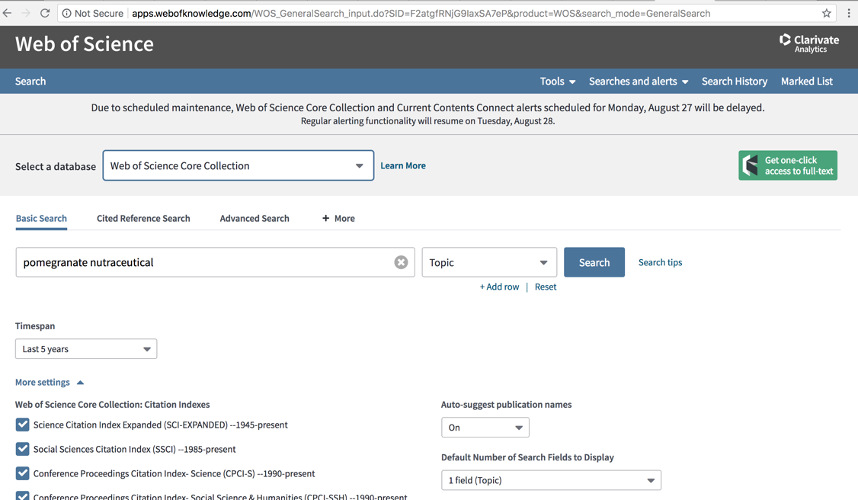

Slide 16
Video for learning https://www.youtube.com/watch?v=wsgo4BYp4So

Slide 17
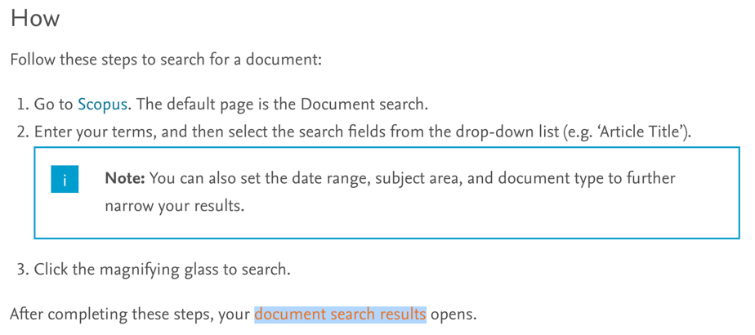
Scopus will find citations in major journals and scholarly websites.
https://tutorials.scopus.com/EN/BasicSearch/index.html

Slide 20
Go to Google Scholar (https://scholar.google.com/).
Search for the text you are interested in.
Have a look at the texts in the results list.

Slide 22
To find reputable journals, look for those listed in one or more of the following
Lists produced by associations where only reputable journals are selected for listing
The Directory of Open Access Journals (DOAJ) -An online directory that indexes quality open access,peer-reviewed journals http://doaj.org
The Journal Guide -Journal lists that can be sorted bydisciplinehttps://www.journalguide.com
The Ulrich’s Web Global Serials Directory -Can be limited to peer-reviewed journals(open access or subscription–based)http://www.ulrichsweb.com/ulrichsweb/faqs.asp
The Web of Science Journal Citation Reports -A multidisciplinary index to journals with impact factorshttp://thomsonreuters.com/journal-citation-reports/
Scopus –An abstract and citation database including benchmarking and analytical tools that allowresearchersand librarians better compare and evaluate journals http://www.elsevier.com/online-tools/scopus
Widiastuti Setyaningsih widisety.com

