Slide 1
Literature search
Materi Kuliah Metodologi Penelitian dan Rancangan Percobaan
TPHP-FTP UGM

Slide 2
OVERVIEW
Phenomena (part 1)
A literature search?
Step by step for literature search
Web based method
Web of Science
Scopus
Google Scholar
Citation? (part 2)
The quick guide to referencing
Systems for referencing
Citation Style
APA (American Psycological Association)
Harvard
Reference management software
Mendeley
How to check plagiarism

Slide 3
A reference must be provided if you :
Citation
is the way you tell your readers that certain material in your work came from another source.
quote (use someone else’s exact words)
copy (use figures, tables or structure)
paraphrase (convert someone else’s ideas into your own words)
summarise (use a brief account of someone else’s ideas).

Slide 4
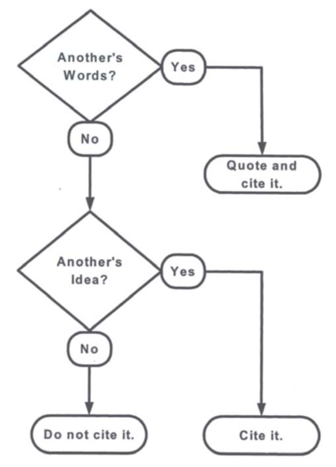
The quick guide to referencing
(Harris, 2001)

Slide 5
References must be provided whenever you use someone else’s opinions, theories, data or organisation of material.

Slide 6
Systems for referencing
1. Note systems
These involve the use of sequential numbers as in-text markers that refer to either footnotes or endnotes.
Footnotes: these are notes included at the end of each page.
Endnotes: these are notes on a separate page at the end of a paper
Common note systems include Chicago and Vancouver.
2. Parenthetical systems
Also known as Author-date or Harvard referencing, parenthetical referencing involves the use of a partial reference contained within parenthesis as in-text markers (such as the author and date). The complete reference is then included in a list on the last page of the document.
Common parenthetical systems include APA, Harvard, and MLA.

Slide 7
Citation style
APA (American Psycological Association). APA is an author/date based style. This means emphasis is placed on the author and the date of a piece of work to uniquely identify it.
Harvard. Harvard is very similar to APA. Where APA is primarily used in the USA, Harvard referencing is the most well used referencing style in the UK and Australia, and is encouraged for use with the humanities.
MLA (Modern Language Association). MLA is most often applied by the arts and humanities, particularly in the USA. It is arguably the most well used of all of the citation styles.
Vancouver. The Vancouver system is mainly used in medical and scientific papers.
Chicago and Turabian. These are two separate styles but are very similar, just like Harvard and APA. These are widely used for history and economics.

Slide 8
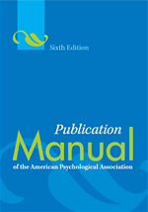
APA (American Psycological Association)
https://libguides.library.usyd.edu.au/ld.php?content_id=22193083
https://www.mendeley.com/guides/apa-citation-guide
https://guides.lib.monash.edu/citing-referencing/apa-websites-social-media

Slide 11
A DOI is a unique, permanent identifier assigned to articles in many databases. Always include the DOI if one is provided (usually in the article’s full-text, abstract or database record).

Slide 14
Video for learning
https://www.youtube.com/watch?v=uyuKfmh2mZE

Slide 15
Harvard
https://guides.lib.monash.edu/citing-referencing/harvard
https://guides.lib.monash.edu/ld.php?content_id=8481587
https://www.intec.edu.do/downloads/documents/biblioteca/formatos-bibliograficos/harvard-author-date-referencing.pdf
https://www.mendeley.com/guides/harvard-citation-guide

Slide 17
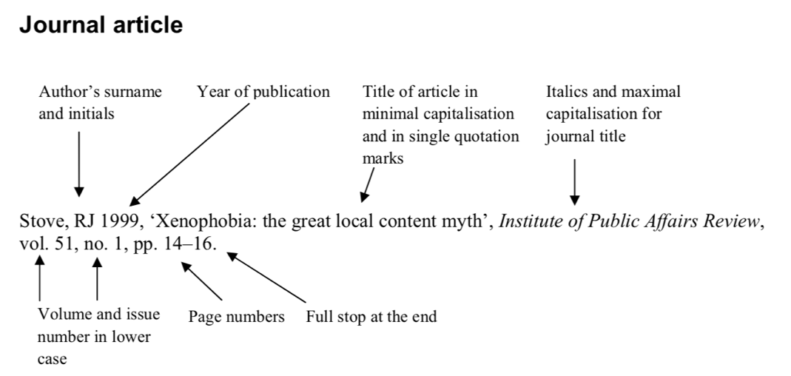

Slide 19
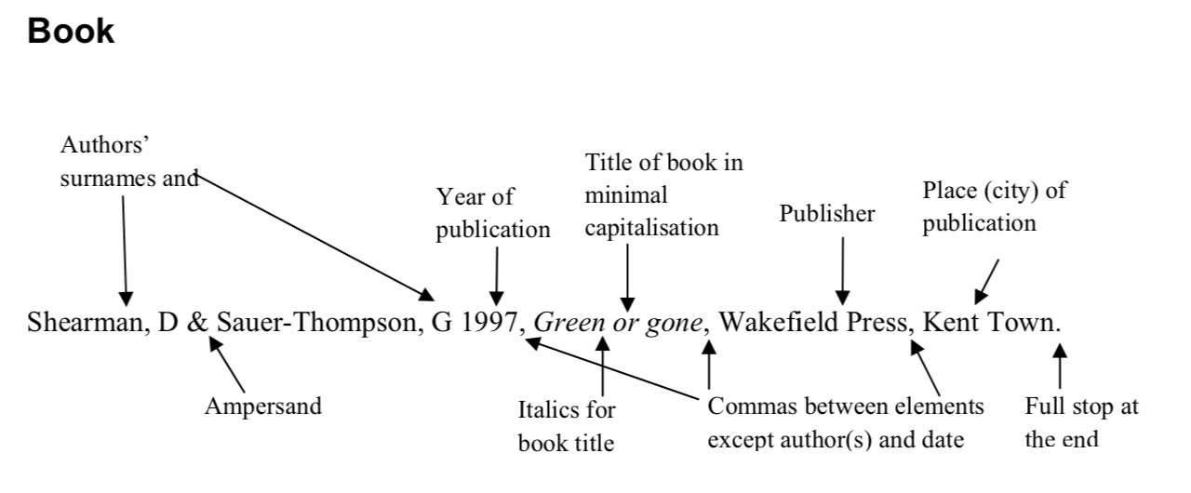

Slide 21
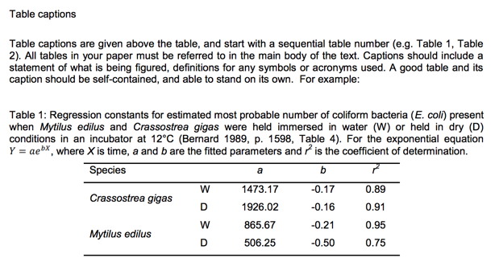

Slide 22
WHICH CITATION SYSTEM SHOULD YOU USE?
If you want to submit a journal article, follow the AUTHOR GUIDE for citation.
If you want to submit your thesis / dissertation, follow the THESIS WRITING GUIDE BOOK.
IMPORTANT : BE CONSISTENT !

Slide 23
Reference management software

Slide 24
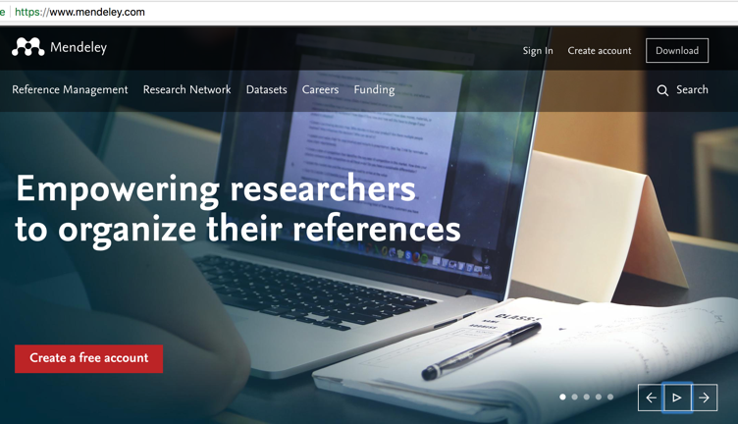
Cite as you write
Annotate as you read
Organize your content
Access your research anywhere

Slide 25
Ayo gunakan software Mendeley…

Slide 26
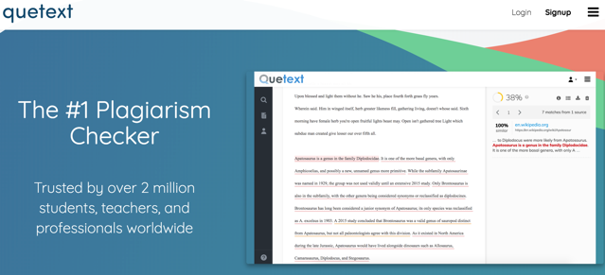
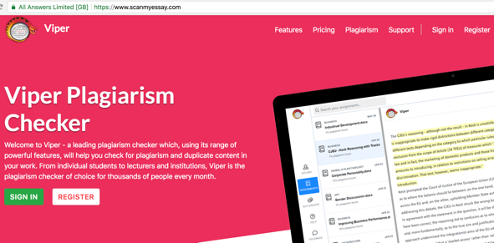
How to check plagiarism?
Viper (https://www.scanmyessay.com/)
QUETEXT (https://www.quetext.com/)

Slide 27
TUGAS KELOMPOK DAN INDIVIDU
3. 30/8 | Pengamatan fenomena, penelusuran pustaka, cara mensitir pustaka. | LDW | SA
PR 2. | Mencari fenomena yang terjadi di lingkungan sekitar (bidang TPHP), dan diuraikan Mencari minimal 3 pustaka pada jurnal terkait fenomena no. 1. Merangkum isi pustaka yang dibaca Membuat referensi dari artikel jurnal / review yang di dapatkan sesuai system APA dan Harvard (in text & reference list)

