Slide 1
Micromolecules
Presented by : Lucia Dhiantika Witasari

Slide 2
Overview
Water
Vitamins
Activated carrier molecules
Ions

Slide 3
The micromolecules are represented by inorganic compounds like water and mineral and organic compounds like simple sugars, lipids, amino acids and nucleotides.

Slide 5
Water is the most abundant Substance in Cells

Slide 6
Biomolecules

Slide 10
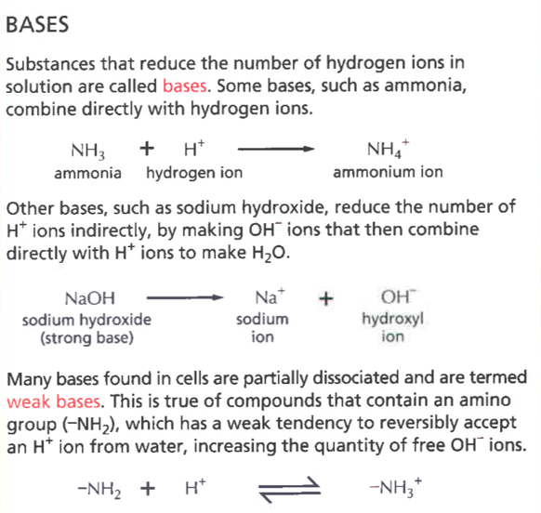
ACIDS vs BASES

Slide 11
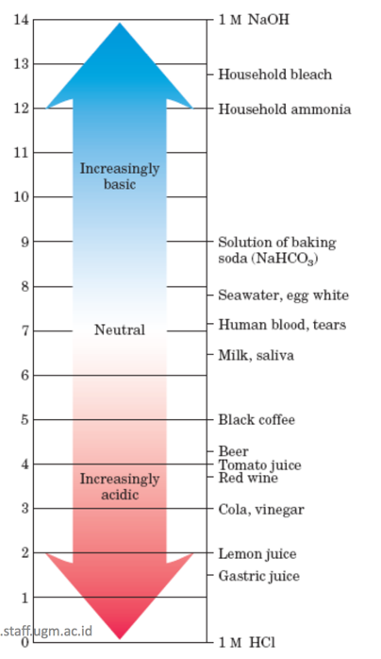

Slide 14
VITAMINS
The water-soluble vitamins
vitamin C (ascorbate, an antioxidant)
vitamin B complex (components of coenzymes).
The fat-soluble vitamins
vitamin A (a precursor of retinal, furnishes the visual pigment of the vertebrate eye and also a regulator of gene expression during epithelial cell growth.)
vitamin D (a regulator of calcium and phosphorus metabolism)
vitamin E (an antioxidant in membranes, the protection of membrane lipids from oxidative damage)
vitamin K (a participant in the carboxylation of glutamate, also essential in the blood-clotting process).

Slide 15
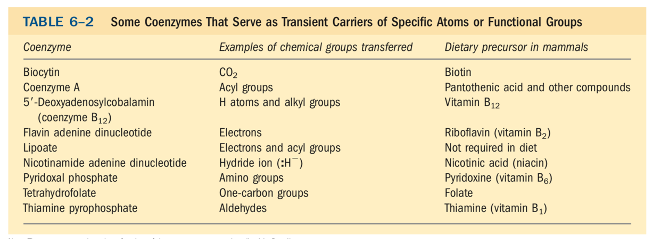
Vitamins Are Often Precursors to Coenzymes
Coenzymes act as transient carriers of specific functional groups. Most are derived from vitamins, organic nutrients required in small amounts in the diet.

Slide 16
VIT C
Vitamin C or ascorbic acid (Ascorbate) is required for the hydroxylation of proline residues in collagen, a key protein of connective tissue.
Scurvy is a deficiency disease caused by lack of vitamin C.
Scurvy is characterized by general degeneration of connective tissue. Manifestations → numerous small hemorrhages caused by fragile blood vessels, tooth loss, poor wound healing and the reopening of old wounds, bone pain and degeneration, and eventually heart failure.
So why is ascorbate so necessary to good health?
its role in the formation of collagen.

Slide 17
The hydroxylation of specific Pro residues in pro-collagen, the precursor of collagen, requires the action of the enzyme prolyl 4-hydroxylase. This enzyme requires 𝛂-ketoglutarate in their reactions.
The ascorbate consumed in the reaction presumably functions to reduce the heme iron and restore enzyme activity.

Slide 18
Why plants are such good sources of vitamin C?
In plants, ascorbate is required as a substrate for the enzyme ascorbate peroxidase, which converts H₂O₂ to water. The peroxide is generated from the O₂ produced in photosynthesis.
Ascorbate is a also a precursor of oxalate and tartrate in plants, and is involved in the hydroxylation of Pro residues in cell wall proteins called extensins.
Ascorbate is found in all subcellular compartments of plants, at concentrations of 2 to 25 mM.
Eat your fresh fruit and vegetables

Slide 19
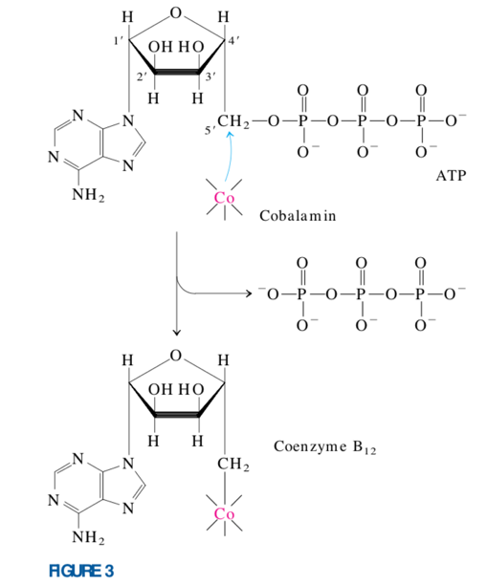
VIT B12
Vitamin B12 as usually isolated is called cyanocobalamin, because it contains a cyano group (picked up during purification) attached to cobalt in the sixth coordination position
Coenzyme B12 is the cofactor form of vitamin B12, which is unique among all the vitamins → contains not only a complex organic molecule but an essential trace element, cobalt.

Slide 20
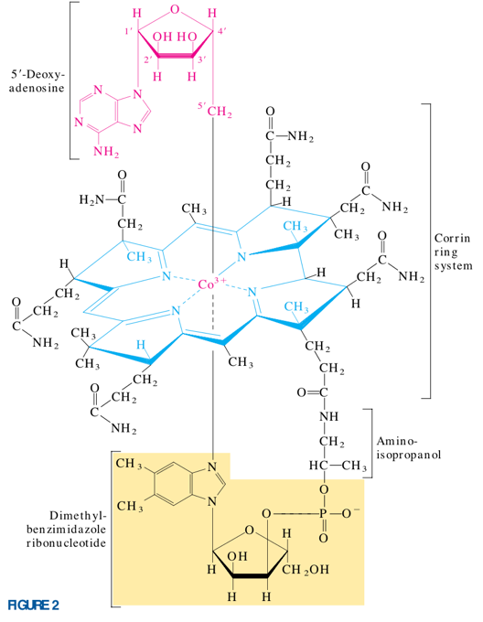
The complex corrin ring system of vitamin B12 (colored blue), to which cobalt (as Co³⁺⁾ is coordinated, is chemically related to the porphyrin ring system of heme and heme proteins.

Slide 21
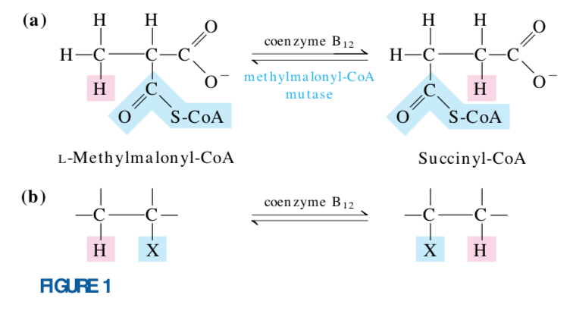
An exchange of an alkyl or sub- stituted alkyl group (X) with a hydrogen atom on an adjacent carbon, with no mixing of the transferred hydrogen atom with the hydrogen of the solvent, H2O.

Slide 22
Pernicious anemia
Individuals with this disease do not produce sufficient amounts of intrinsic factor, a glycoprotein essential to vitamin B12 absorption → failure to absorb vitamin B12 efficiently from the intestine.
The pathology in pernicious anemia includes reduced production of erythrocytes, reduced levels of hemoglobin, and severe, progressive impairment of the central nervous system.

Slide 23
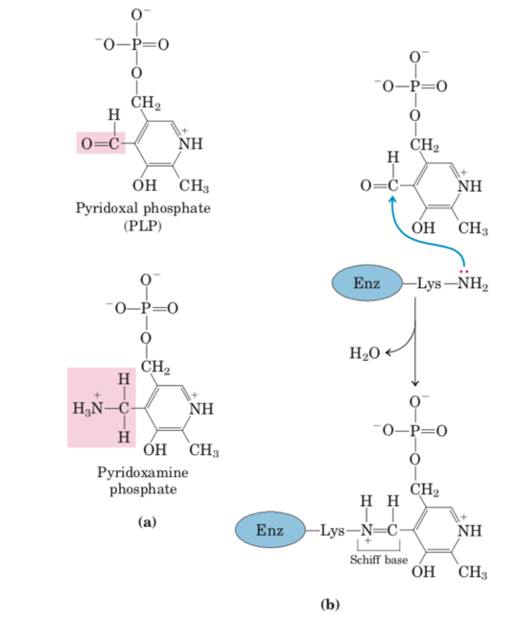
VIT B6
All aminotransferases have the same prosthetic group and the same reaction mechanism. The prosthetic group is pyridoxal phosphate (PLP), the coenzyme form of pyridoxine, or vitamin B6.
Pyridoxal phosphate functions as an intermediate carrier of amino groups at the active site of aminotransferases.

Slide 24
The first step in the catabolism of most L-amino acids, once they have reached the liver, is removal of the 𝛂 - amino groups, promoted by enzymes called amino- transferases or transaminases.
In these transamination reactions, the 𝛂 -amino group is transferred to the 𝛂 -carbon atom of 𝛂-ketoglutarate, leaving behind the corresponding 𝛂 -keto acid analog of the amino acid

Slide 25
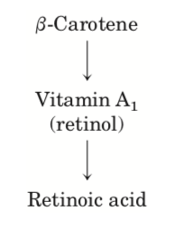
Vitamins A and D Are Hormone Precursors

Slide 26
VIT A

Slide 27
Retinoid Hormones
Retinoids are potent hormones that regulate the growth, survival, and differentiation of cells via nuclear retinoid receptors.
The prohormone retinol is synthesized from vitamin A, primarily in liver, and many tissues convert retinol to the hormone retinoic acid (RA).
All tissues are retinoid targets, as all cell types have at least one form of nuclear retinoid receptor.
In adults, the most significant targets include cornea, skin, epithelia of the lungs and trachea, and the immune system.
RA regulates the synthesis of proteins essential for growth or differentiation.

Slide 28
Functions of vit A
Vitamin A (retinol) functions as a hormone and as the visual pigment of the vertebrate eye.
good dietary sources of vitamin A : liver, eggs, whole milk, and butter are good dietary sources.
In vertebrates, 𝛽-carotene, the pigment that gives carrots, sweet potatoes, and other yellow vegetables their characteristic color, can be enzymatically converted to vitamin A.
Deficiency of vitamin A leads to a variety of symptoms in humans, including dryness of the skin, eyes, and mucous membranes; retarded development and growth; and night blindness, an early symptom commonly used in diagnosing vitamin A deficiency.
Excessive vitamin A can cause birth defects, and pregnant women are advised not to use the retinoid creams that have been developed for treatment of severe acne

Slide 29
VIT D
Cholecalciferol (vitamin D3) is produced in the skin by UV irradiation of 7-dehydrocholesterol, which breaks the bond shaded pink. In the liver, a hydroxyl group is added at C-25 (pink); in the kidney, a second hydroxylation at C-1 (pink) produces the active vit. D hormone, Calcitriol, 1,25-dihydroxycholecalciferol. This hormone regulates the metabolism of Ca²⁺ in kidney, intestine, and bone.

Slide 30
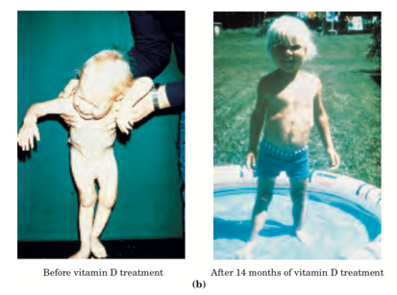
Functions of Vit. D hormone / Calcitriol
Calcitriol works in concert with parathyroid hormone in Ca²⁺ homeostasis, regulating [Ca²⁺ ] in the blood and the balance between Ca²⁺ deposition and Ca²⁺ mobilization from bone. Acting through nuclear receptors, calcitriol activates the synthesis of an intestinal Ca²⁺ - binding protein essential for uptake of dietary Ca²⁺ .
In-adequate dietary vitamin D or defects in the biosynthesis of calcitriol result in serious diseases such as rickets, in which bones are weak and malformed

Slide 31
Vitamins E and K and the Lipid Quinones Are Oxidation-Reduction Cofactors

Slide 32
VIT E
Vitamin E belongs to a group of lipids called tocopherols, contain a substituted aromatic ring and a long isoprenoid side chain.
Because they are hydrophobic, tocopherols associate with cell membranes, lipid deposits, and lipoproteins in the blood.
Tocopherols are biological antioxidants. The aromatic ring reacts with and destroys the most reactive forms of oxygen radicals and other free radicals, protecting unsaturated fatty acids from oxidation and preventing oxidative

Slide 33
VIT K
The aromatic ring of vitamin K undergoes a cycle of oxidation and reduction during the formation of active prothrombin, a blood plasma protein essential in blood clot formation.
Prothrombin is a proteolytic enzyme that splits peptide bonds in the blood protein fibrinogen to convert it to fibrin, the insoluble fibrous protein that holds blood clots together.
Henrik Dam and Edward A. Doisy discovered that vitamin K deficiency slows blood clotting.

Slide 34
ACTIVATED CARRIER MOLECULES
ATP
NADH and NADPH
FADH2 and FMNH2

Slide 35
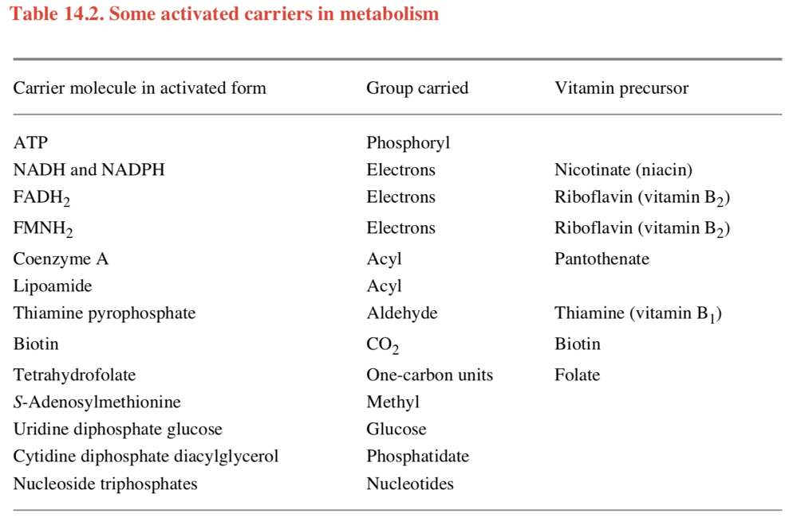

Slide 36
ATP is the most widely used activated carrier molecule
ATP (Adenosine triphosphate) is a convenient and versatile store of currency, of energy used to drive a variety of chemical reactions in cells.
ATP is synthesized in an energetically unfavorable phosphopylation reaction in which a phosphate group is added to ADP (adenosine diphosphate)
When required, ATP gives up its energy packet through its energetically favorable hydrolysis to ADP and inorganic phosphate.
ATP hydrolysis is coupled to many otherwise unfavorable reactions through which other molecules are synthesized.
For example : ATP supplies energy for pumps that transport substances into and out of the cell.

Slide 38
NADH and NADPH are important electron carriers
NAD+ (nicotinamide adenine dinucleotide) and NADP+ (nicotinamide adenine dinucleotide phosphate) are activated carrier molecules which specialized to carry high-energy electrons and hydrogen atoms.
Vitamin niacin is the source of the nicotinamide moiety
They participate in oxidation-reduction reactions and are commonly part of coupled reactions in cells. Ex : oxidations of fuels such as pyruvate, fatty acid and 𝛂 keto acid
NAD+ and NADP+ each pick up a “packet of energy” corresponding to two high-energy electrons plus a proton (H+) being converted to NADH (reduced NAD) and NADPH (reduced NADP).
NADH and NADPH → carriers of hydride ions (the H+ plus two electrons, or H-)

Slide 39
NADPH vs NADH
The phosphate group on NADPH has NO effect on the electron-transfer properties of NADPH compared with NADH→ it give a different molecule shape of NADPH from that of NADH → possible for NADPH and NADH to bind as substrates to completely different sets of enzymes.
NADPH operates with enzymes that catalyze anabolic reactions, → supplying the high-energy electrons needed to synthesize energy-rich biological molecules.
NADH is an intermediate in the catabolic system of reactions that generate ATP through the oxidation of food molecules.
Inside the cell, the ratio of NAD+ to NADH is kept high, whereas the ratio of NADP+ to NADPH is kept low.
This provides plenty of NAD+ to act as an oxidizing agent and plenty of NADPH to act as a reducing agent – as required for their special roles in catabolism and anabolism, respectively

Slide 40
NADPH readily gives up the hydride ion because the nicotinamide ring can achieve a more stable arrangement of electrons without it.

Slide 43
Dietary Deficiency of Niacin, the Vitamin Form of NAD and NADP, Causes Pellagra
The pyridine-like rings of NAD and NADP are derived from the vitamin niacin (nicotinic acid), which is synthesized from tryptophan.
Niacin deficiency, which affects all the NAD(P)-dependent dehydrogenases, causes the serious human disease pellagra (Italian for “rough skin”)
These diseases are characterized by the “three Ds”: dermatitis, diarrhea, and dementia, followed in many cases by death.
Pellagra is still found among alcoholics, whose intestinal absorption of niacin is much reduced

Slide 44
Flavin Nucleotides Are Tightly Bound in Flavoproteins
Flavoproteins are enzymes that catalyze oxidation-reduction reactions using either flavin mononucleotide (FMN) or flavin adenine dinucleotide (FAD) as coenzyme.
These coenzymes, the flavin nucleotides, are derived from the vitamin riboflavin.
flavoproteins can participate in either one- or two-electron transfers. They can serve as intermediates between reactions in which two electrons are donated (as in dehydrogenations) and those in which only one electron is accepted (as in the reduction of a quinone to a hydroquinone).
When a fully oxidized flavin nucleotide accepts only one electron (one hydrogen atom), the semiquinone form of the isoalloxazine ring is produced, abbreviated FADH• and FMNH•
The fully reduced forms are abbreviated FADH2 and FMNH2.

Slide 47
Flavin nucleotides in some enzymes is bound covalently

Slide 48
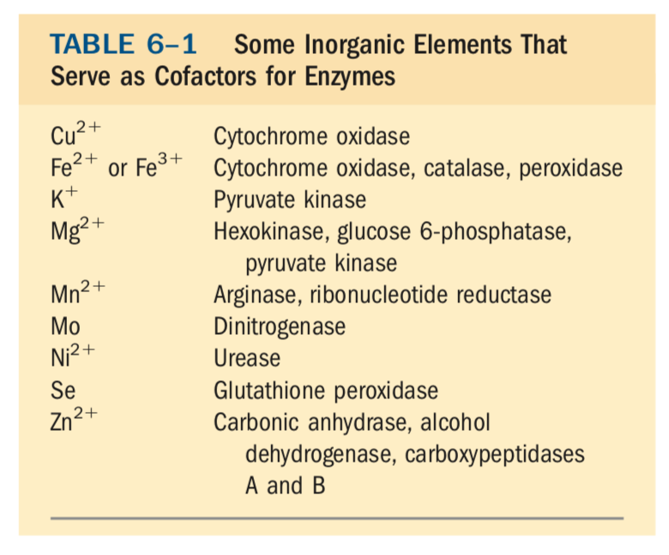
IONs

Slide 49
Calcium Is a Second Messenger in Many Signal Transductions
In many cells that respond to extracellular signals, Ca²⁺ serves as a second messenger that triggers intracellular responses, such as exocytosis in neurons and endocrine cells, contraction in muscle, and cytoskeletal rearrangement during amoeboid movement.
Normally, cytosolic [Ca²⁺] is kept very low (< 10⁻⁷ M) by the action of Ca²⁺ pumps in the ER, mitochondria, and plasma membrane.
Hormonal, neural, or other stimuli cause either an influx of Ca²⁺ into the cell through specific Ca²⁺ channels in the plasma membrane or the release of sequestered Ca²⁺ from the ER or mitochondria, in either case raising the cytosolic [Ca²⁺ ] and triggering a cellular response.

Slide 50
Calmodulin
Changes in intracellular [Ca²⁺ ] are detected by Ca²⁺ -binding proteins that regulate a variety of Ca²⁺ - dependent enzymes. Calmodulin (CaM) (Mr 17,000) is an acidic protein with four high-affinity Ca²⁺ -binding sites. When intracellular [Ca²⁺ ] rises to about 10⁻⁶ M (1 𝛍M), the binding of Ca²⁺ to calmodulin drives a conformational change in the protein.

Slide 52
References
Lehninger, A. L., Nelson, D. L., & Cox, M. M. (2000). Lehninger principles of biochemistry. New York, Worth Publishers.
Berg, J. M., Tymoczko, J. L., & Stryer, L. (2007). Biochemistry (6th ed.). New York: W.H. Freeman.
Alberts, B., Johnson, A., Lewis, J., Raff, M., Roberts, K., & Walter, P. (2002). Molecular biology of the cell. New York: Garland Science.

