Slide 1
SURVEY
& SAMPLING DESIGN
Presented by : Lucia Dhiantika Witasari

Slide 2

Survey Research
Searching for actual information
Finding justification of fenomena
Supporting the decisión maker
Psychology Today
Widiastuti Setyaningsih widisety.com

Slide 3
An EXAMPLE

Slide 4
Steps in Survey
What information/data need to be collected
Defining the study population
Decide sampling design
Questionnaire design
Fieldwork
Quality Assurance
Data entry/compilation
Analysis
Dissemination
Plans for next survey
Widiastuti Setyaningsih widisety.com

Slide 5
Sampling Issues in Survey
• Produce best estimation
• Not too low, not too large → sample size
• Minimum error/unbiased estimation
• Economic consideration
• Design consideration: best collection strategy
Widiastuti Setyaningsih widisety.com

Slide 6


Slide 7
Population and sample
Population: The entire set of individuals about which findings of a survey refer to.
Sample: A subset of population selected for a study.
Sample Design: The scheme by which items are chosen for the sample.
Sample unit: The element of the sample selected from the population.
Unit of analysis: Unit at which analysis will be done for inferring about the population. Consider that you want to examine the effect of health care facilities in a community on prenatal care.

Slide 8
Characteristics of Good sampling
Meet the requirements of the study
Provides reliable results
Clearly understandable
Manageable/realistic: could be implemented
Time consideration: reasonable and timely
Cost consideration: economical
Interpretation: accurate, representative
Acceptability
Widiastuti Setyaningsih widisety.com

Slide 9
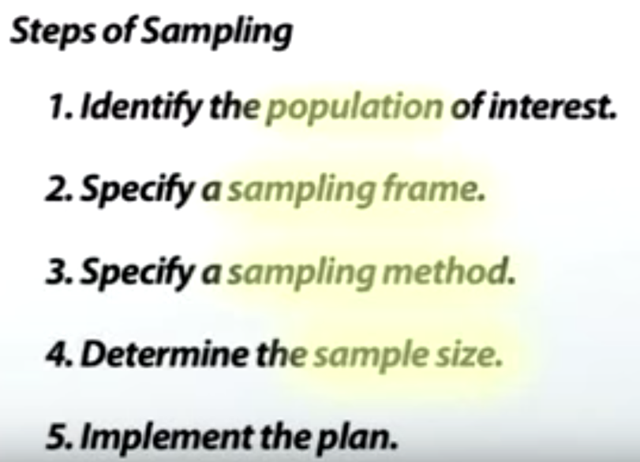

Slide 10
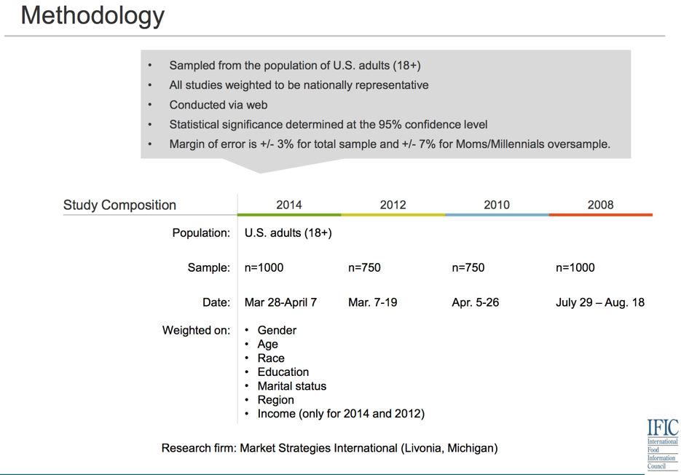

Slide 11
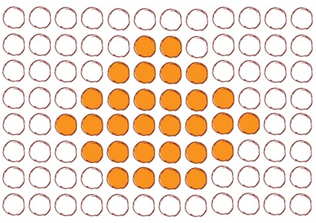
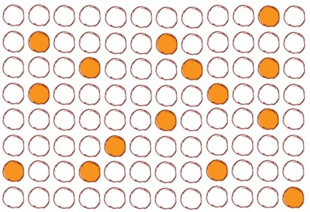
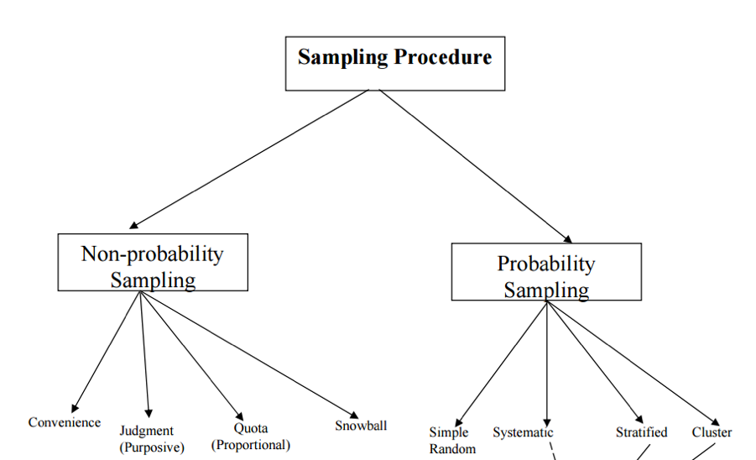
non-probability sampling – based on researcher's choice, population that accessible & available.
probability sampling – based on chance events (such as random numbers, flipping a coin etc.)
Widiastuti Setyaningsih widisety.com

Slide 12
Video for learning : https://www.youtube.com/watch?v=pTuj57uXWlk

Slide 13
Probability sampling
Simple random. Every individual has an equal and independent probability of being selected in the sample.
Systematic. involves drawing every nth element in the population starting with a randomly chosen element between 1 and n. the researcher may decide to include study participants using a fixed pattern.
Stratified. In a stratified sample, the population is divided into two or more similar groups (based on demographic or clinical characteristics). The sample is recruited from each stratum. The researcher may use a simple random sample procedure within each stratum.
Cluster. The sample is selected from larger units or “clusters.” This type of method is generally used for “community-based studies.”
Multistage. combine multiple methods for the appropriate and required sample.

Slide 14
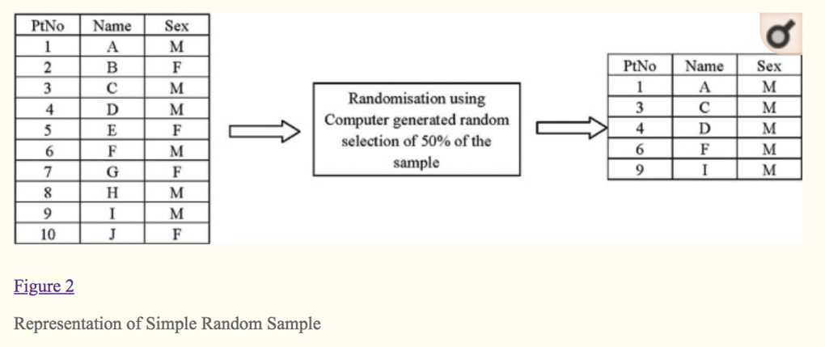

Slide 15
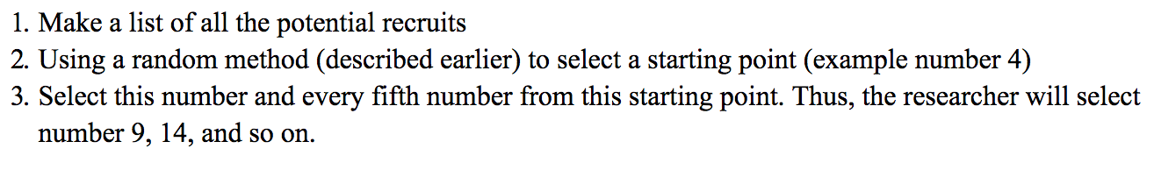
Steps for systematic random sample

Slide 16
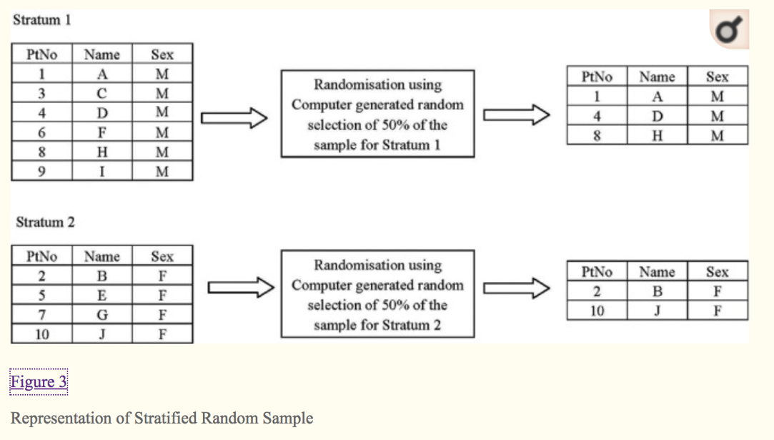

Slide 17
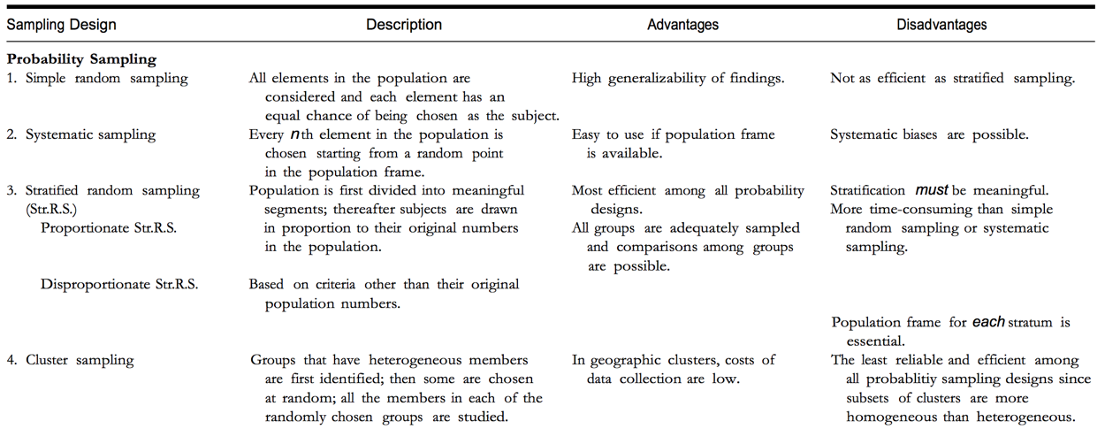
(Sekaran, 2003)

Slide 18
Non-probability sampling
Convenience sampling
  applicable to qualitative or quantitative studies.
  subjects more readily accessible to the researcher are more likely to be included.
  Thus, in quantitative studies, opportunity to participate is not equal for all qualified individuals in the target population and study results are not necessarily generalizable to this population
Purposive sampling
  is typically used in qualitative studies.
  Researchers who use this technique carefully select subjects based on study purpose with the expectation that each participant will provide unique and rich information of value to the study.
  As a result, members of the accessible population are not interchangeable and sample size is determined by data saturation not by statistical power analysis.

Slide 21
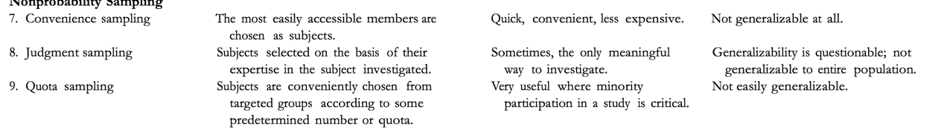

Slide 22
For descriptive statistics, to have 95% confidence level in estimating population parameters using a sample, use :
Krejcie and Morgan (1970) Table.
  Sekaran, U. (2003). Research methods for business: A skill-building approach. New York: John Wiley & Sons.
Bartlett’s Table.
  Bartlett, J.E., Kotrlik, J.W., Higgins, C.C. (2001). Determining appropriate sample size in survey research. Information Technology, Learning, and Performance Journal, 19 (1), pp. 43-50.

Slide 23
SAMPLE SIZE

Slide 24
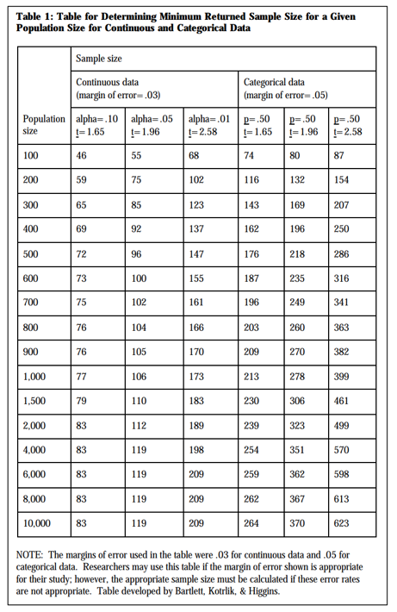
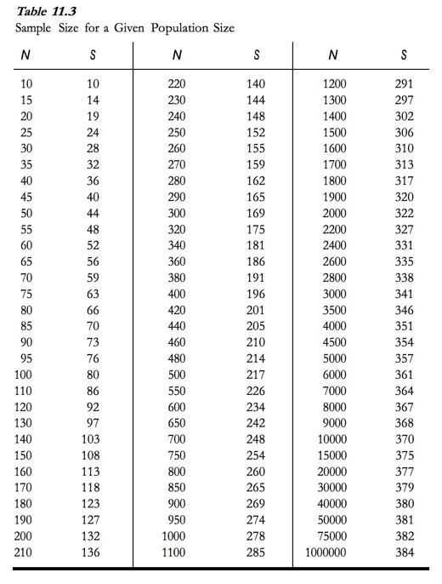
Krejcie and Morgan (1970) Table
Bartlett’s Table

Slide 25
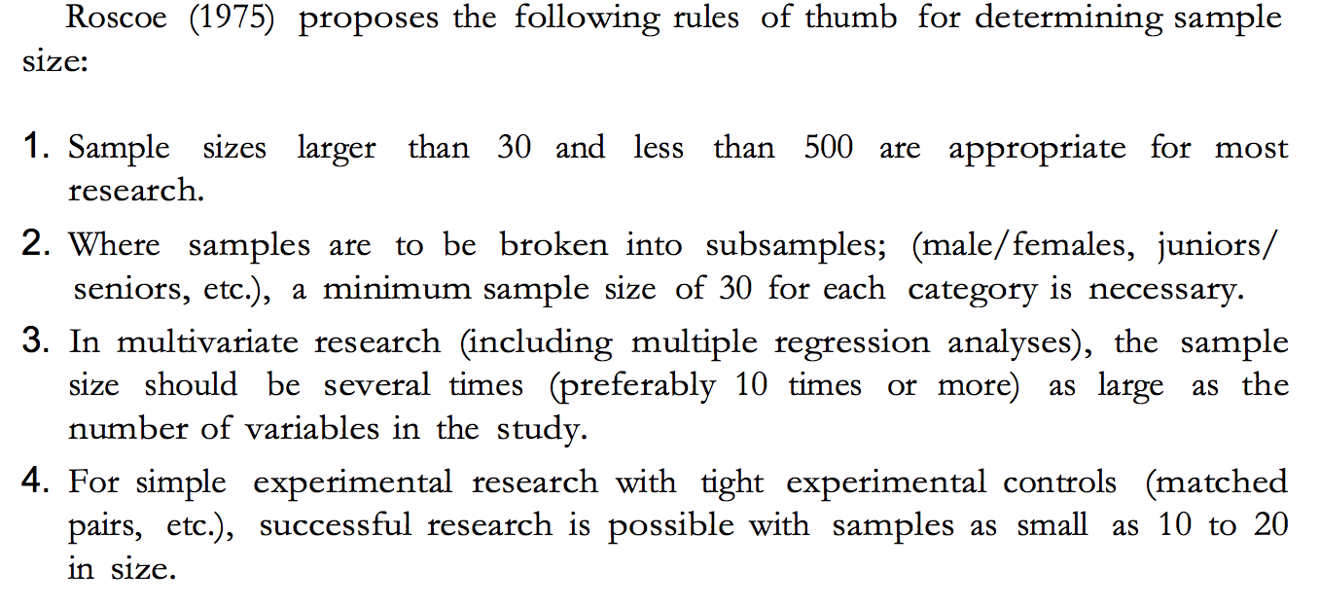

Slide 26
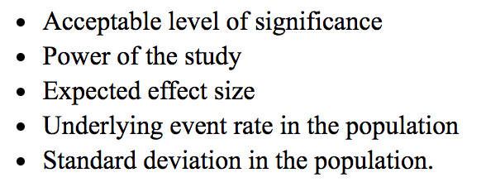
SAMPLE SIZE DETERMINATION for Inferential Statistical Analysis
depends on :
(Kirby et al., 2002)

Slide 27
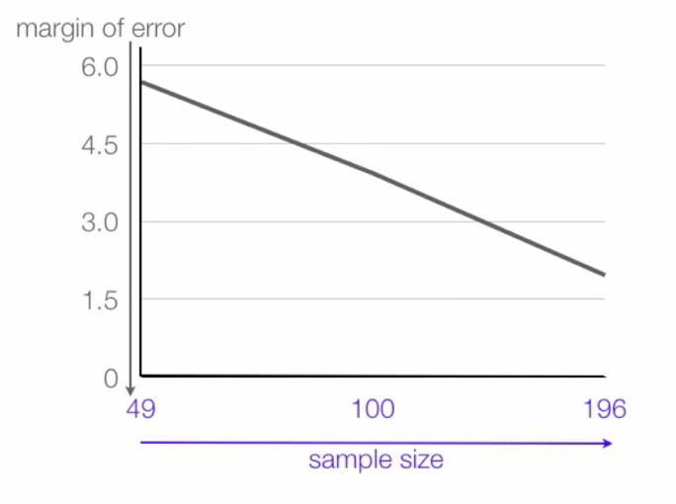
The larger the sample size is, the more accurate we can expect the sample estimates to be

Slide 28
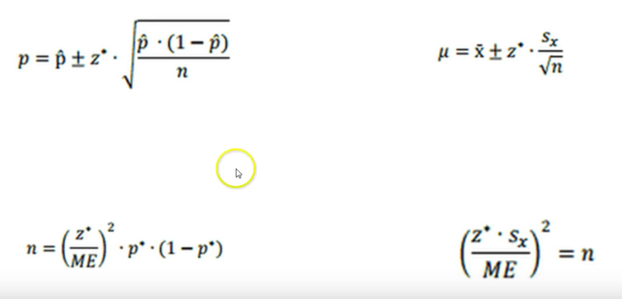
Formula

Slide 29
Learn more… https://www.youtube.com/watch?v=PoRl4qLv3BI

Slide 30
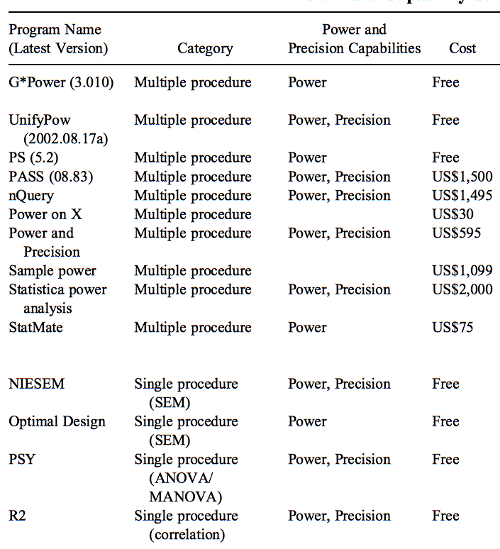
Software for Sample Size Determination
Dattalo, P. (2009). A Review of Software for Sample Size Determination. Evaluation & the Health Professions, 32(3), 229-248. https://doi.org/10.1177/0163278709338556

Slide 31
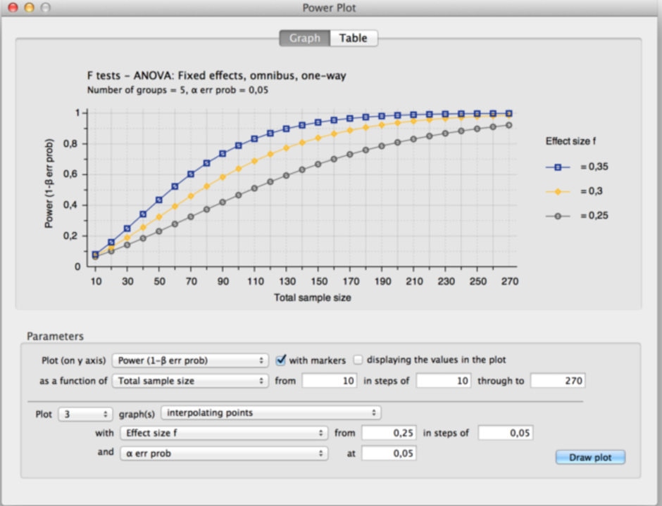
G*Power

Slide 32
An example for the scope of surveys
An observation on healthiness of people reside in Yogyakarta was conducted by a researcher from FTP UGM between September 20 to 27, 2016, and the survey reported that 29% adults suffer of DM, with a margin of error of 3%. The result was based on blood analysis of 872 adults
Widiastuti Setyaningsih widisety.com

Slide 33
Point estimate
Study population
An observation on healthiness of people reside in Yogyakarta was conducted by a researcher from FTP UGM between September 20 to 27, 2016, and the survey reported that 29% adults suffer of DM, with a margin of error of 3%. The result was based on blood analysis of 872 adults
Extent of
Sampling Error
Sample size
Widiastuti Setyaningsih widisety.com

Slide 34
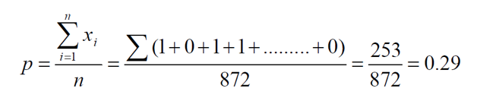
Can the researcher conclude that her research has shown that DM threat people in Yogyakarta?
29% “yes”, and 71% “no”
Let p = 0.29, and q = 1 – p = 0.71.
So, 872 X 0.29 = 253 responded “Yes”, and
872 X 0.71 = 619 responded “No”.
In summary, from the raw data, Gallup’s statistician estimated that
Here, 1 = “yes”, and 0 = “no” responses
Widiastuti Setyaningsih widisety.com

Slide 35
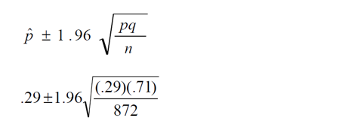

How much confidence do we have on this “point estimate” (29%) ?
From our knowledge of basic statistics, we can construct a 95% confidence interval around p as:
So, 95% CI of p ranges between (.26 to .32). The above mathematical expression could be rephrased as:
Widiastuti Setyaningsih widisety.com

Slide 36
REFFERENCE
Setia, M. S. (2016). Methodology Series Module 5: Sampling Strategies. Indian Journal of Dermatology, 61(5), 505–509. http://doi.org/10.4103/0019-5154.190118
Kadam, P., & Bhalerao, S. (2010). Sample size calculation. International Journal of Ayurveda Research, 1(1), 55–57. http://doi.org/10.4103/0974-7788.59946
Kirby A, Gebski V, Keech AC. Determining the sample size in a clinical trial. Med J Aust. 2002;177:256–7.
Sekaran, U. (2003). Research methods for business: A skill-building approach. New York: John Wiley & Sons.
Bartlett, J.E., Kotrlik, J.W., Higgins, C.C. (2001). Determining appropriate sample size in survey research. Information Technology, Learning, and Performance Journal, 19 (1), pp. 43-50.

